Slide 1
Covid-19 India Statewise Data using EDA
By Jayadarshini

Slide 2
Introduction
COVID-19 affected all Indian states differently.
Statewise data helps understand spread and impact.
EDA is used to analyze patterns, trends, and relationships.
This project studies cases, recovery, deaths, and ratios.
Analyze COVID-19 data across Indian states.
Identify most affected states.Compare active, recovery, and death ratios.
Study relationship between population and cases.Generate insights using visualizations.

Slide 3
Covid-19 India Statewise Data using EDA
DATA DESCRIPTION
TOOL AND THECHNOLOGIES
State
Active Cases
Discharged (Recovered)
Deaths
Active Ratio (%)
Discharge Ratio (%)
Death Ratio (%)
Population
Python
Pandas
Matplotlib
jupyter

Slide 4
Covid-19 India Statewise Data using EDA
Data processing
Exploratory Data Analysis (EDA)
Loaded dataset using pd.read_csv()
Checked column names
Removed extra spaces
Handled missing values
Converted numeric columns
Exploratory Data Analysis (EDA)
Performed:
Data shape and structure analysis
Summary statisticsTop & bottom states analysis
Correlation analysis
EDA helps understand data patterns

Slide 5
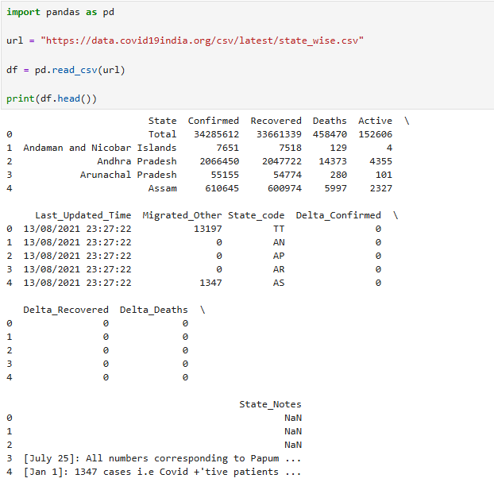
Data loading and initial check
Explanation: pandas is used for data analysis and manipulation.
Import pandas to work with dataset.
URL Store the online CSV link in a variable.
Load DataUse pd.read_csv() to load data into DataFrame.
Display Dataset Use df.head() to check first 5 rows.
Data Understanding Identify columns like:
State
Confirmed
Recovered
Deaths
Active

Slide 6
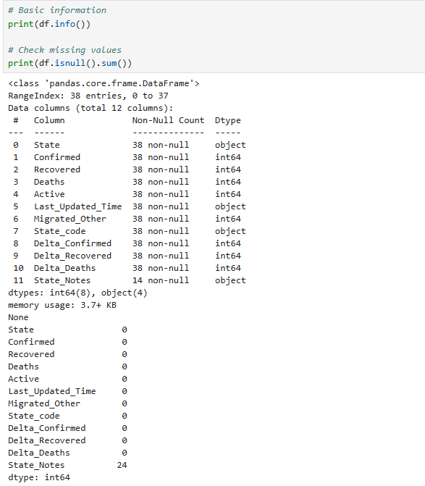
Check Dataset information
Explanation:info() shows column names and data types.
df.isnull().sum() Checks if dataset contains missing values.
Important for data accuracy.
If missing values exist, we handle them.

Slide 7
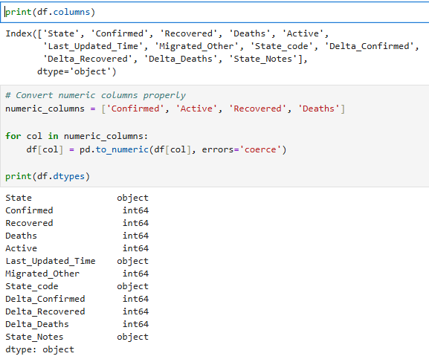
Data set column information
Explanation: df.columns displays column names in the dataset.
numeric_columns selects columns that should contain numeric values.
Converts selected columns into numeric format
errors=‘coerce’ converts invalid values to NaN.
df.dtypes displayes updated data types.

Slide 8
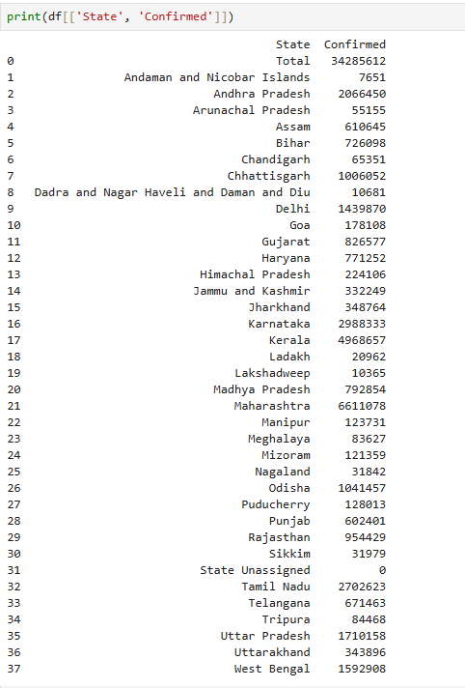
Display state and confirmed cases
Explanation:
Displays only state and confirmed columns.
Shows total confirmed cases for each state.
Helps understand state-wise COVID case distribution.

Slide 9
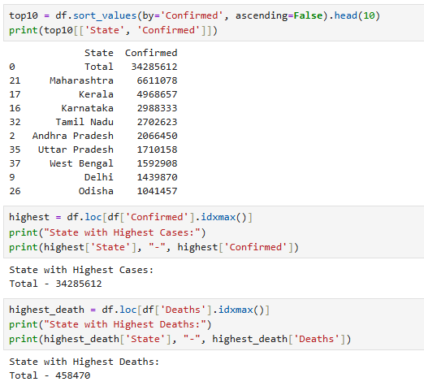
Top 10 states , highest cases and deaths
Explanation:
Sorts states by confirmed cases (highest first).
Displays State and Confirmed columns.
idxmax() finds index of maximum value.
Identifies state with highest confirmed cases.
Finds state with maximum deaths.
Displays state name and death count.

Slide 10
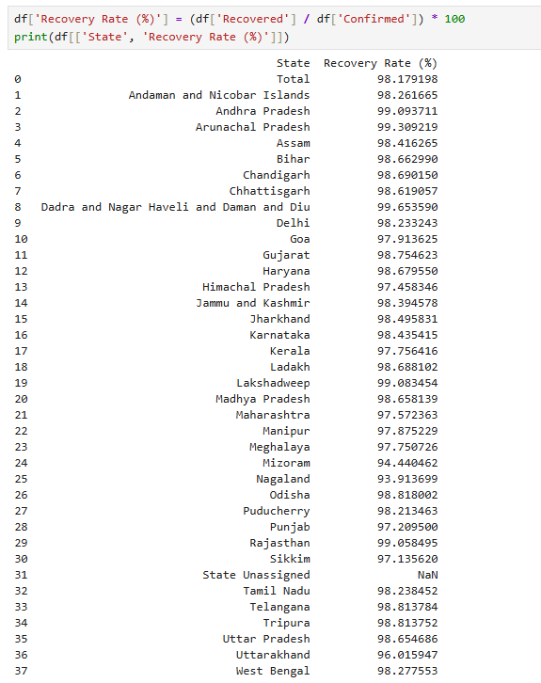
Recovery rate calculation
Explation: Creates new column.
Formula: Recovery Rate = (Recovered ÷ Confirmed) × 100
Shows effectiveness of recovery.

Slide 11
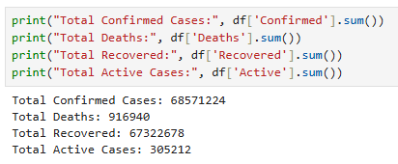
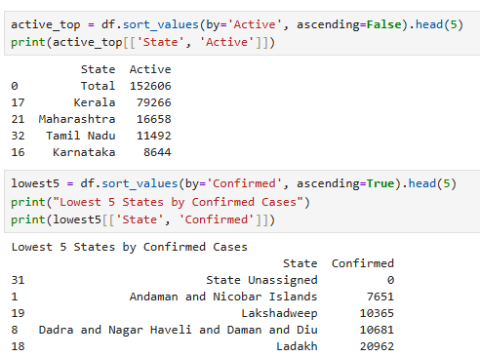
Covid-19 Data summary and state- wise analysis
Explanation
Calculate total cases across all stats
Uses sum() to add column values.
Sorts states by active cases (highest first) and display top 5 states.
Sorts states by active cases (lowest first) and display least 5 states.

Slide 12
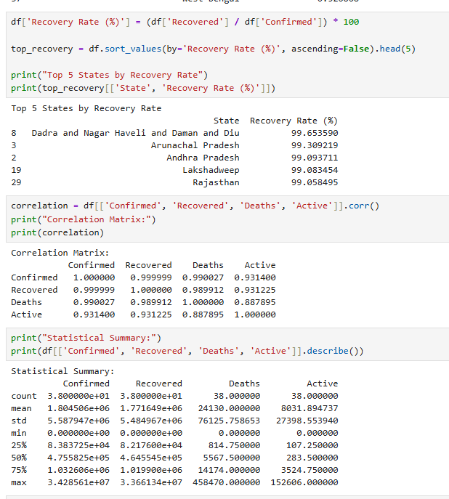
Correlation and statistical analysis
Explanation
Sorts states by highest recovery rate.
Displays top 5 performing states.
Shows relationship between numerical features.
Helps understand how cases, deaths, and recoveries are related.
Provides mean, min, max, std deviation.
Summarizes overall dataset statistics

Slide 13
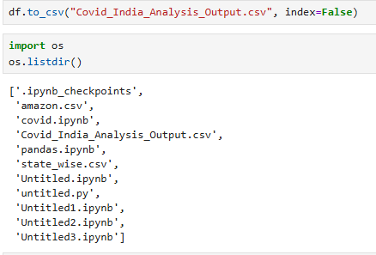
Exporting dataframe into CSV
Explanation:
df.to_csv("Covid_India_Analysis_Output.csv", index=False)
This does any output
A new file is created
File name: Covid_India_Analysis_Output.csv
Saved in your current working folder
It contains all the data from your DataFrame df
Code:
import os
os.listdir()
Covid_India_Analysis_Output.csv

Slide 14
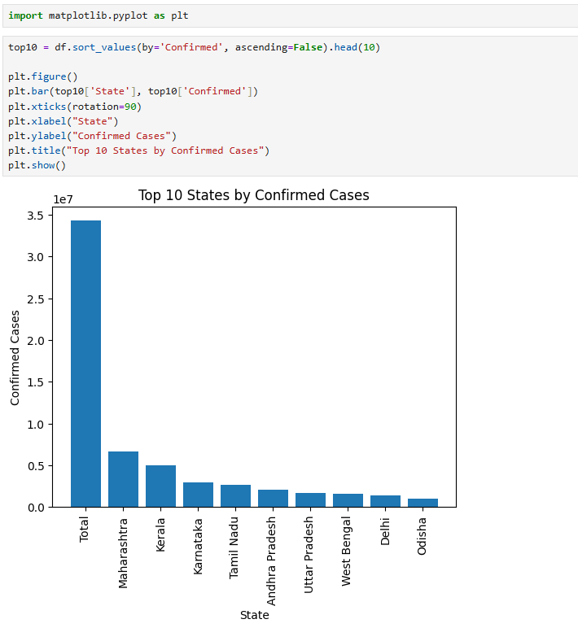
Bar chart top 10 states by confirmed COVID- 19 cases
Explanation:
A bar chat is a grap used to compare different categories using rectangular bars
Sorts states based on highest confirmed cases.
X-axis → States
Y-axis → Confirmed Cases
Helps visually compare most affected states.

Slide 15
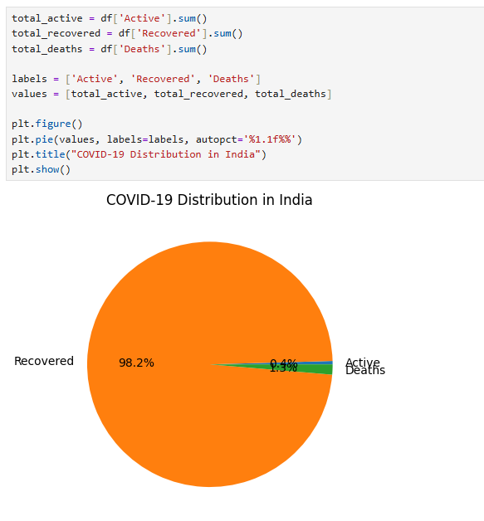
Pie chart COVID -19 Distribution in India
Explanation:
A pie chart is a circular graph used to show the percentage distribution of data.
The circle is divided into slices, and each slice represents a part of the whole.
Explation:
Shows the percentage of
Active – 20%
Recovered – 75%
Deaths – 5%

Slide 16
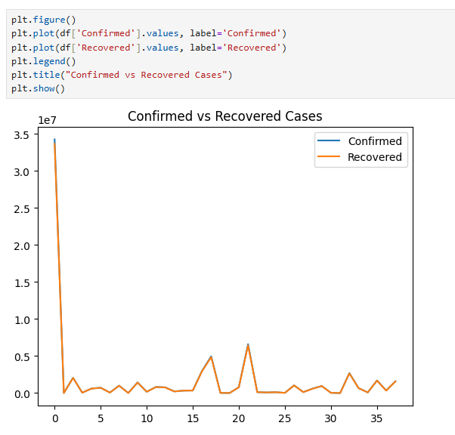
Line chart Confirmed vs Recovered Cases
A line chart shows how data changes continuously over time by joining points with a line.
Explanation:
This graph shows confirmed and recovered cases.
It compares total cases and recovered cases.t
helps understand the COVID situation clearly.

Slide 17
THANK YOU

